Slide 1
Diffusion Limited Aggregation
By Alexander Xu

Slide 2
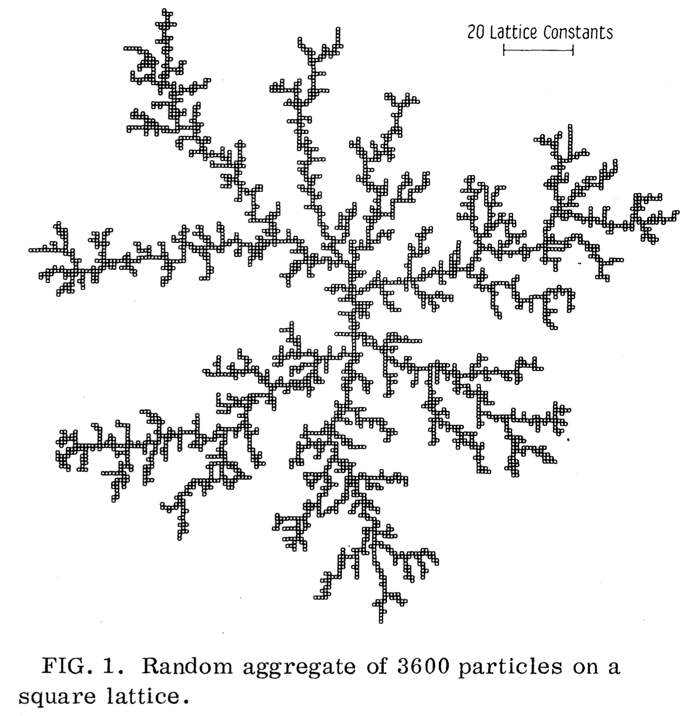
What is DLA?
Diffusion Limited Aggregation (DLA) is a theoretical mathematical model that attempts to simulate how particles that diffuse randomly in space form a cluster. The cluster forms by adding particles to itself on contact. The structures formed are different every time and often have a fractal nature, meaning they look the same at different scales. Similar structures are commonly seen in nature.

Slide 3
How does it work?
(Unbiased Walk)
(Biased Walk)
First, particles are introduced at one of the four borders of the simulation screen. These particles then walk in random directions, simulating random diffusion, until they happen to land adjacent to a particle on the cluster or the cluster seed (starting particle) itself. When this happens, it stops walking and aggregates to the cluster.
Works similarly to the unbiased DLA, but has a biased walk. For example, (as it is in the biased walk later), particles could have a chance of moving specifically to the center.

Slide 4
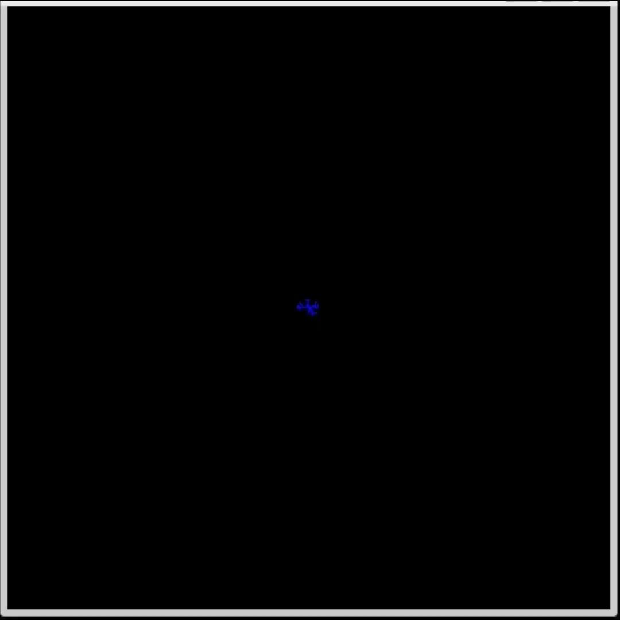
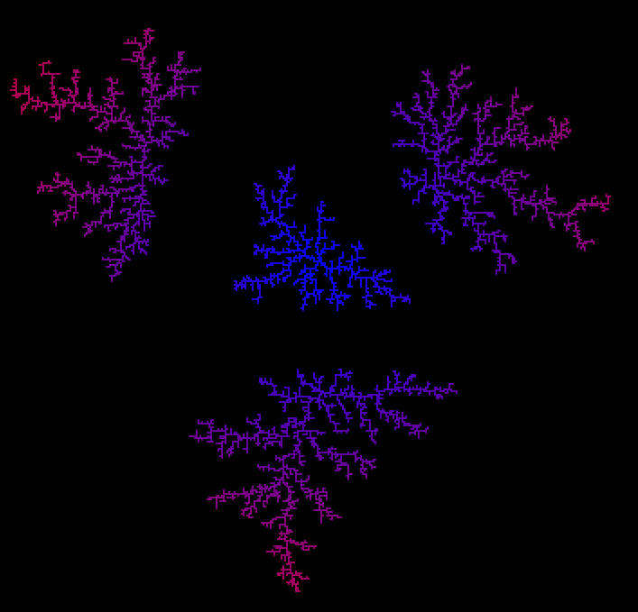
Unbiased Walk Models
Interactive (can place seed particles)

Slide 5
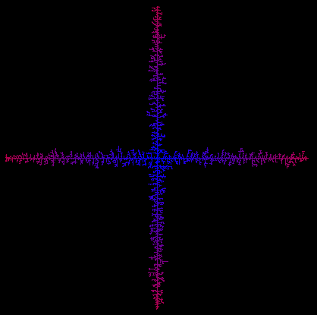
Biased Walk Model
40% chance of walking towards the center

Slide 6
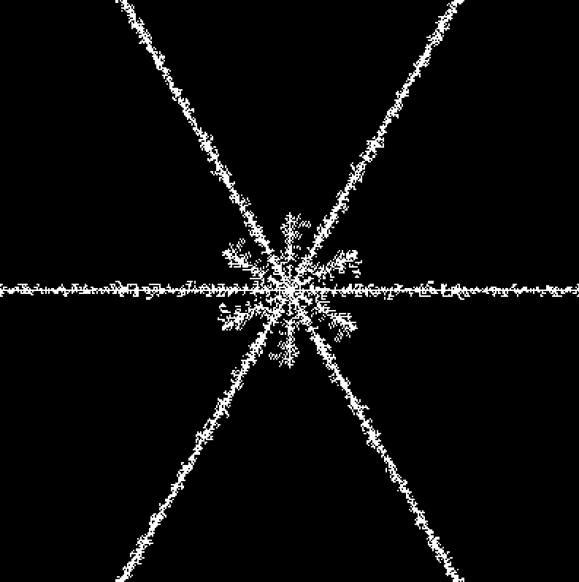
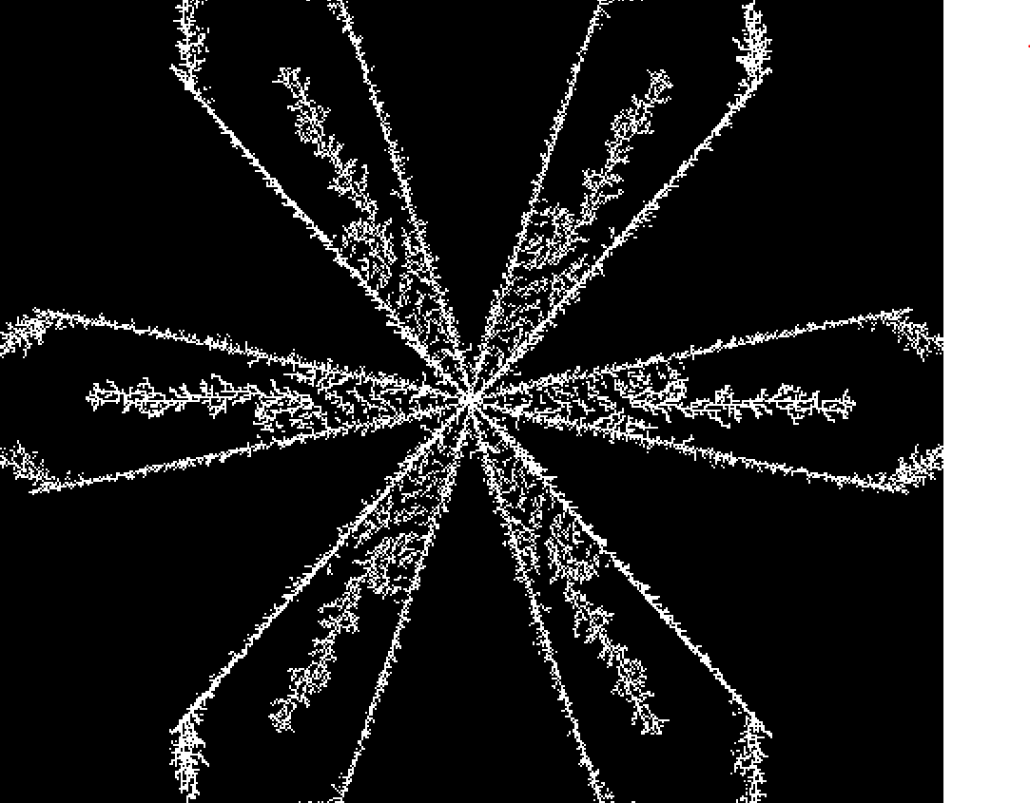
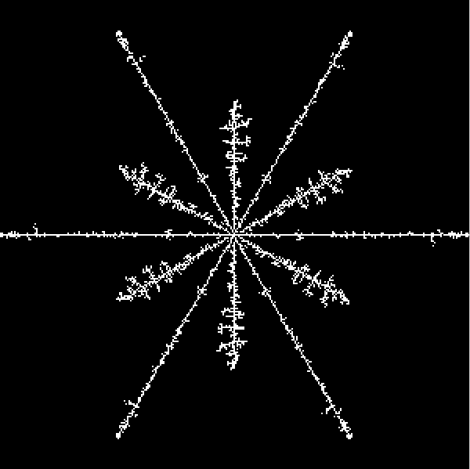
Biased Walk Models (Snowflakes)
These include bias to center, other specific directions and to branching

Slide 7
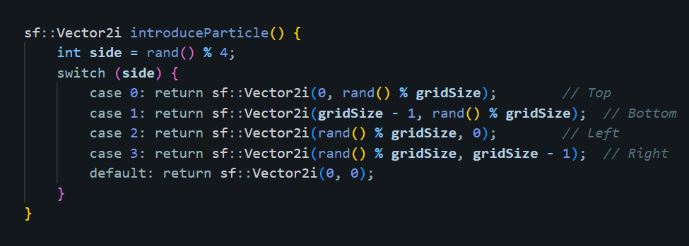
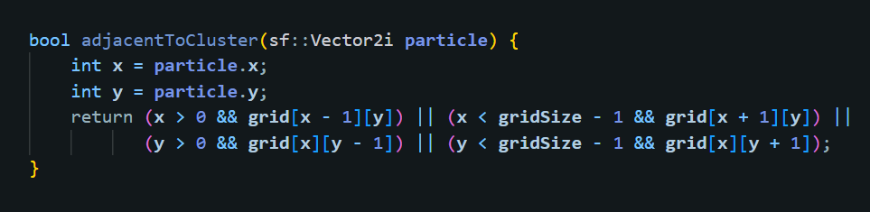
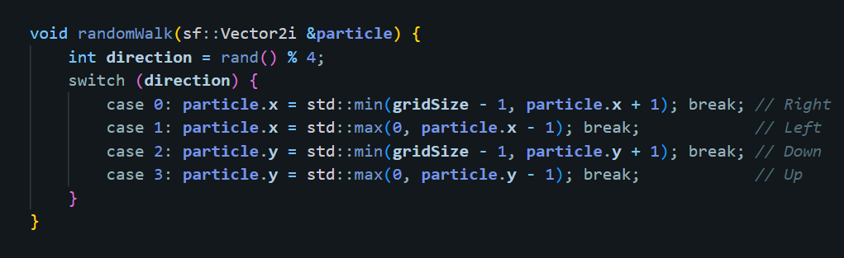
Important Code (Functions)
Introduces a new particle at one of the boundaries.
Checks if the particle is adjacent to a particle in the cluster.
Walks the particle in a random direction.

Slide 8
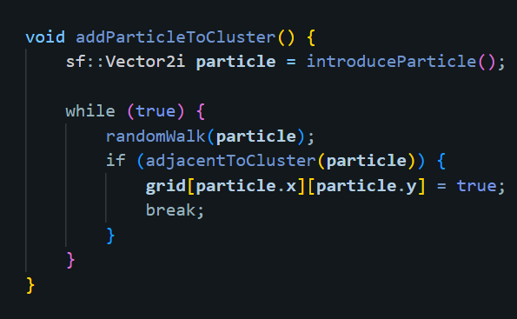
Important Code (Overall adding particles)
Introduces particles, walks them until they are adjacent to the cluster, then adds them to the cluster.

Slide 9
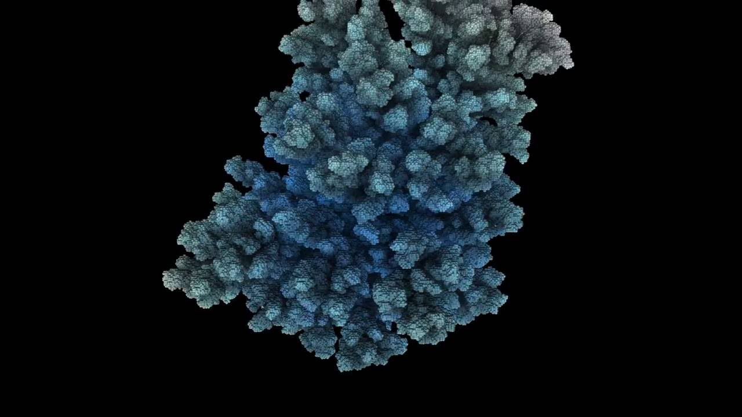
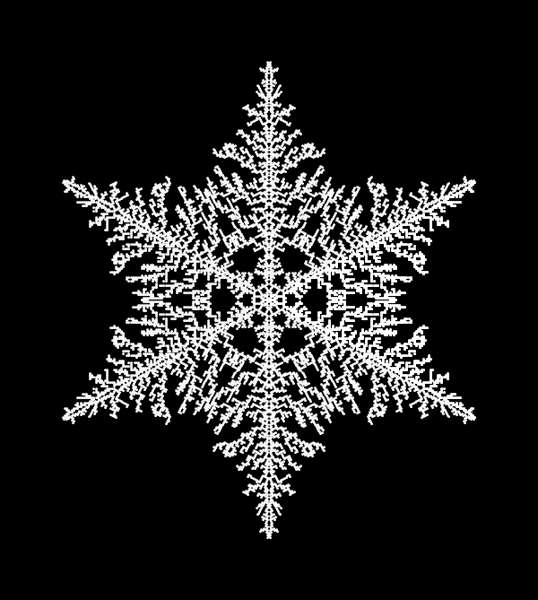
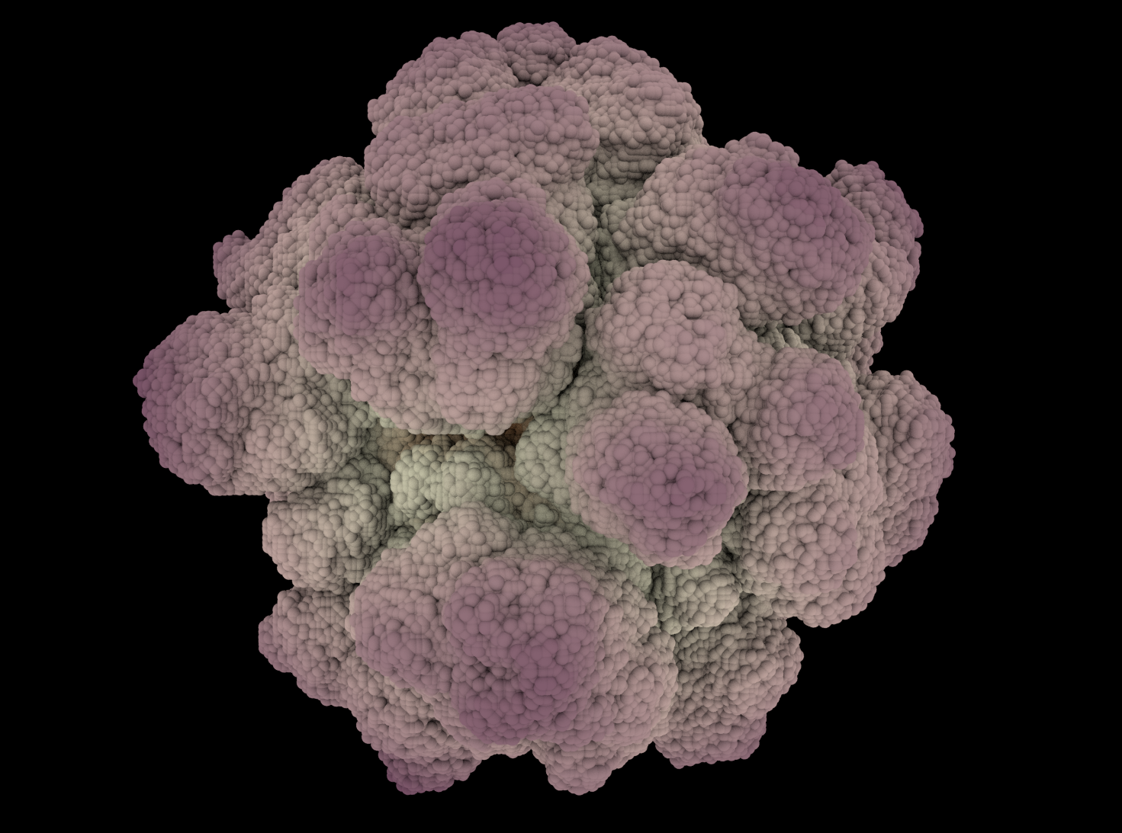
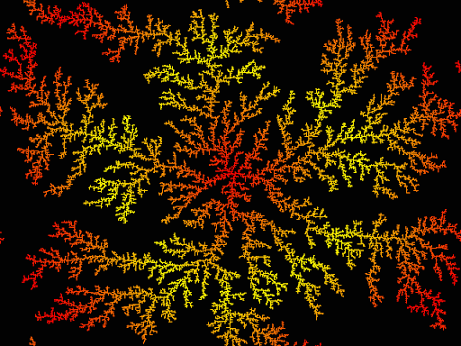
Where Is DLA In Real Life? (Some Examples)
Snowflakes
Mineral Crystals
Lichen Growth
Coral Formation
Dielectric Breakdown
Diffusion of Pollutants

